Slide 1
Welcome!
Data Science and AI
for Systems Engineering
SYSEN 5381
Cornell University
Systems Engineering
Dr. Tim Fraser
Assistant Teaching Professor

Slide 2

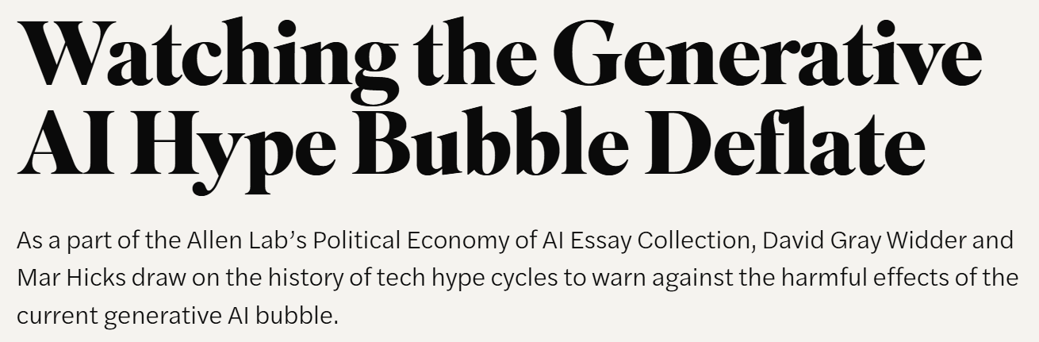

Why are we here?
Sept 2025 - McKinsey concludes 80% of companies surveyed had not seen significant return on investment from AI → the “Gen AI Value Paradox.”
Are there better ways to use LLMs?

Slide 3
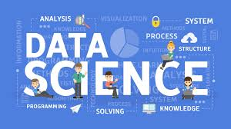
Why are we here?
We want to know…
How do we use AI models (large language models) effectively?
How can Data Science help us use AI models better?
How do we effective build AI agents?
How can AI models help us do Data Science?
How do we make value from LLMs, instead of blah?

Slide 4
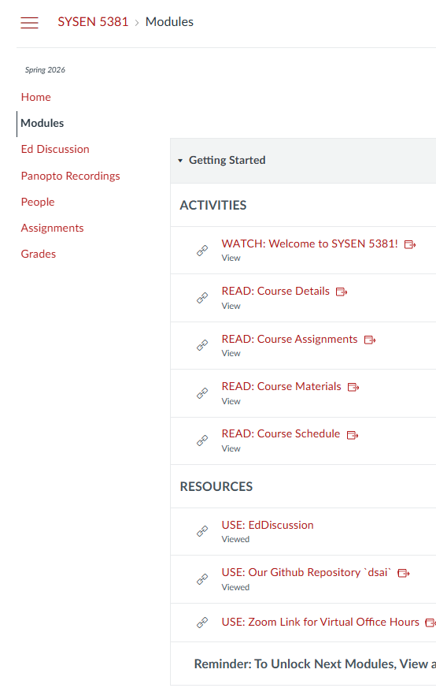
Our Course
Why are we here?
Introductions
Our Canvas Site
canvas.cornell.edu/courses/86527
Getting Started Module
Our Github Repo
github.com/timothyfraser/dsai
Setting up for this Class!
github.com/timothyfraser/dsai/tree/main/00_quickstart

Slide 5
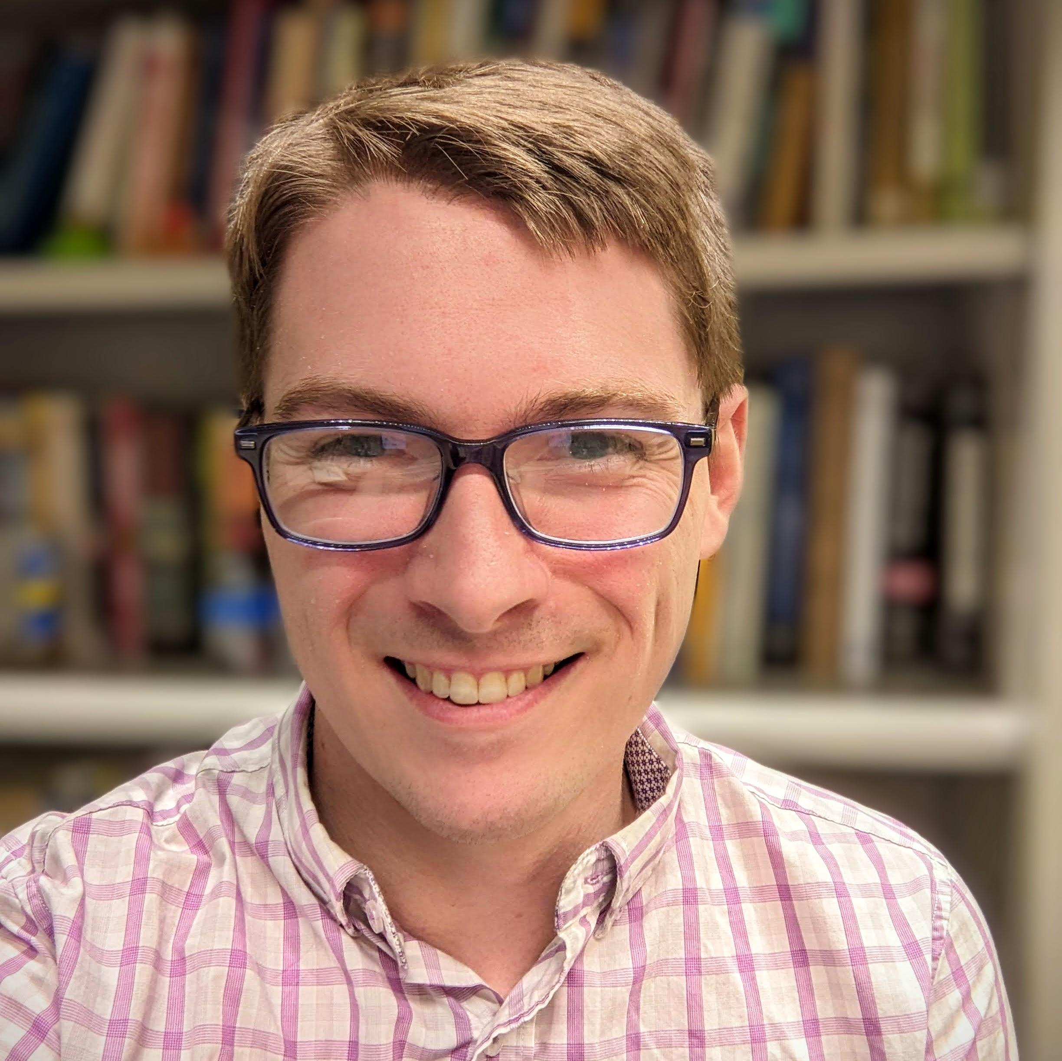
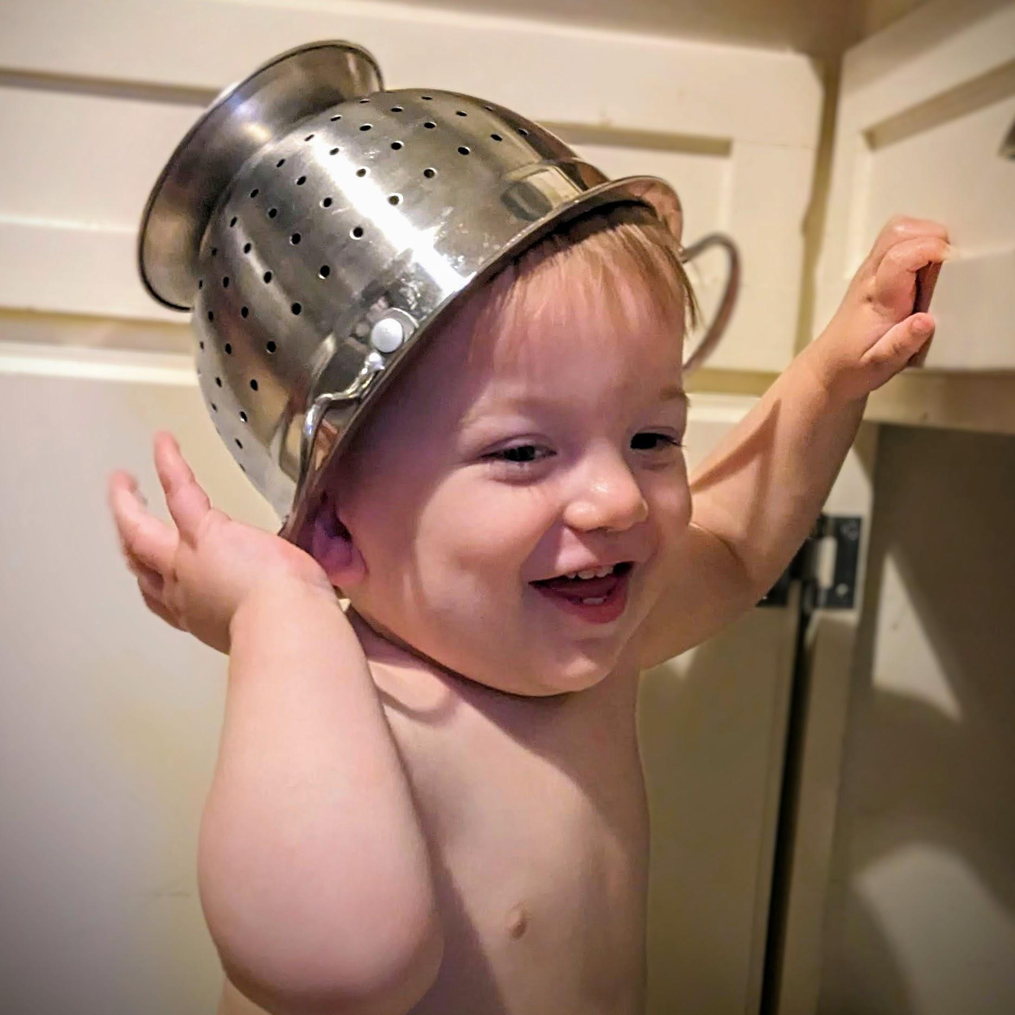
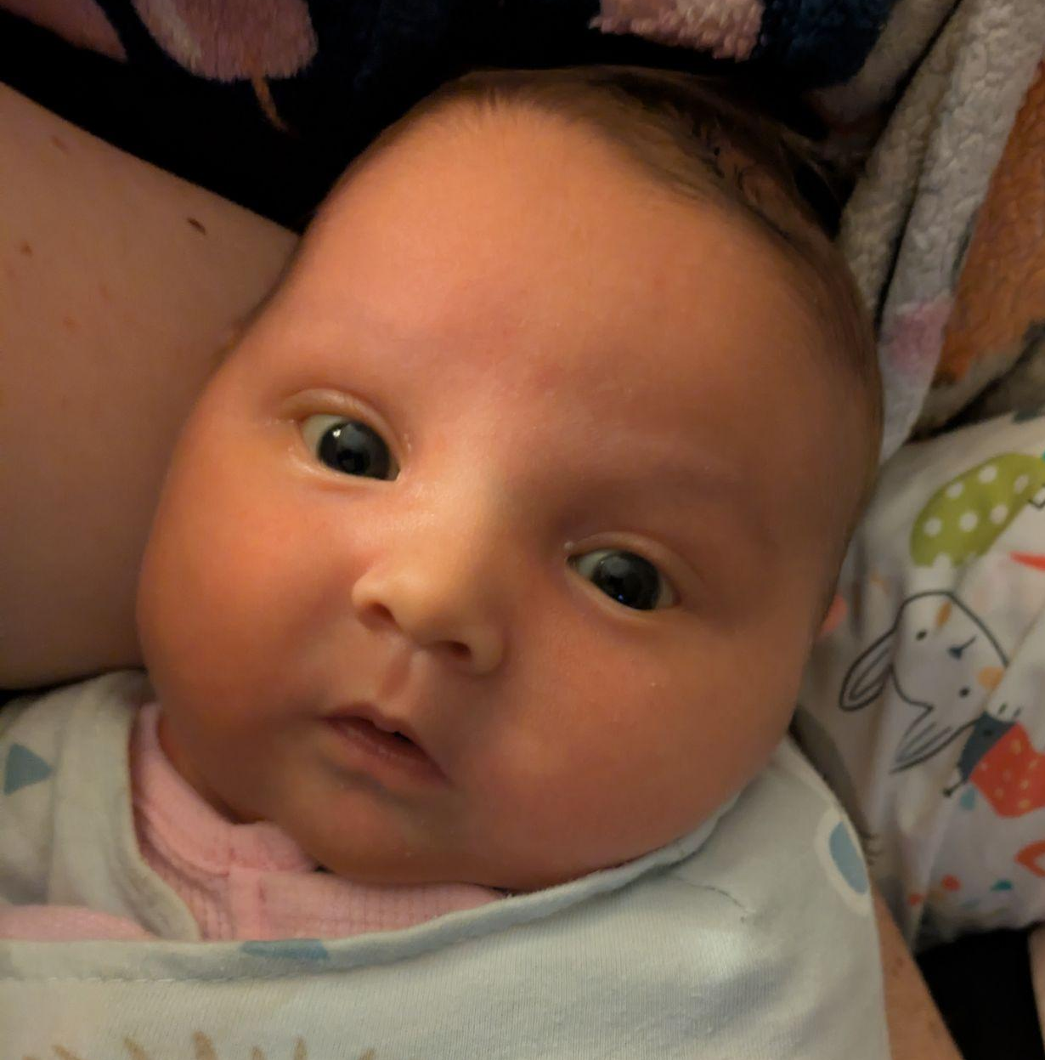
Your Teaching Team
Dr. Tim Fraser
TA Jamie
TA Evie
Asst Teaching Professor
Systems Engineering
Computational Social Scientist
Environmental Policy | Data Science
Department of
Food Science & Naps
Professional Snacker
Blueberries | Chickpeas
Department of
Food Science & Naps
Milk Quality Control Specialist
Milk | Milk | Milk

Slide 6



Teaching Philosophy
Trust
Networks
Skills

Slide 7
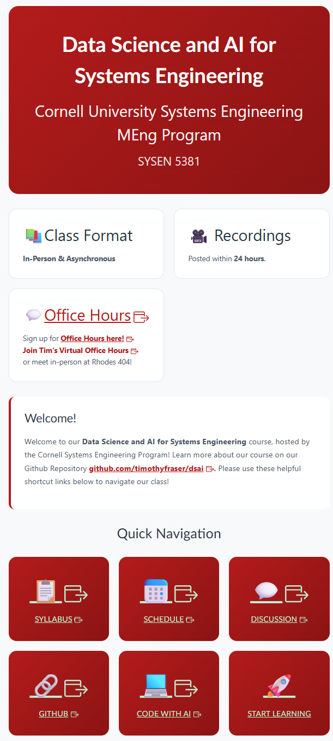
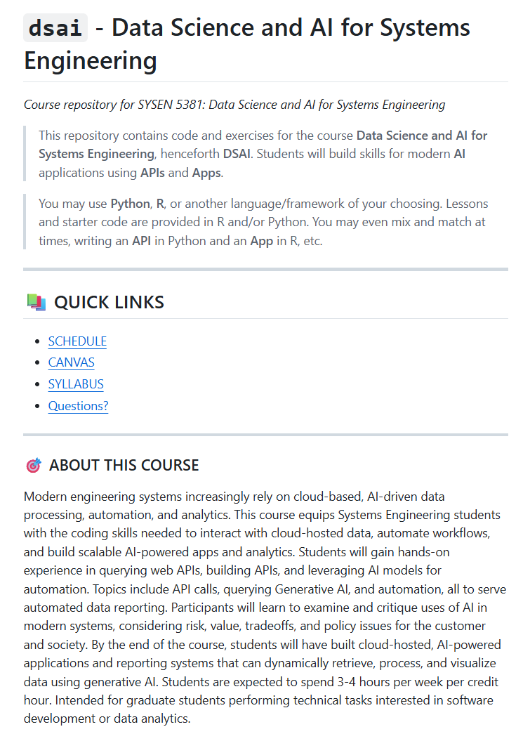
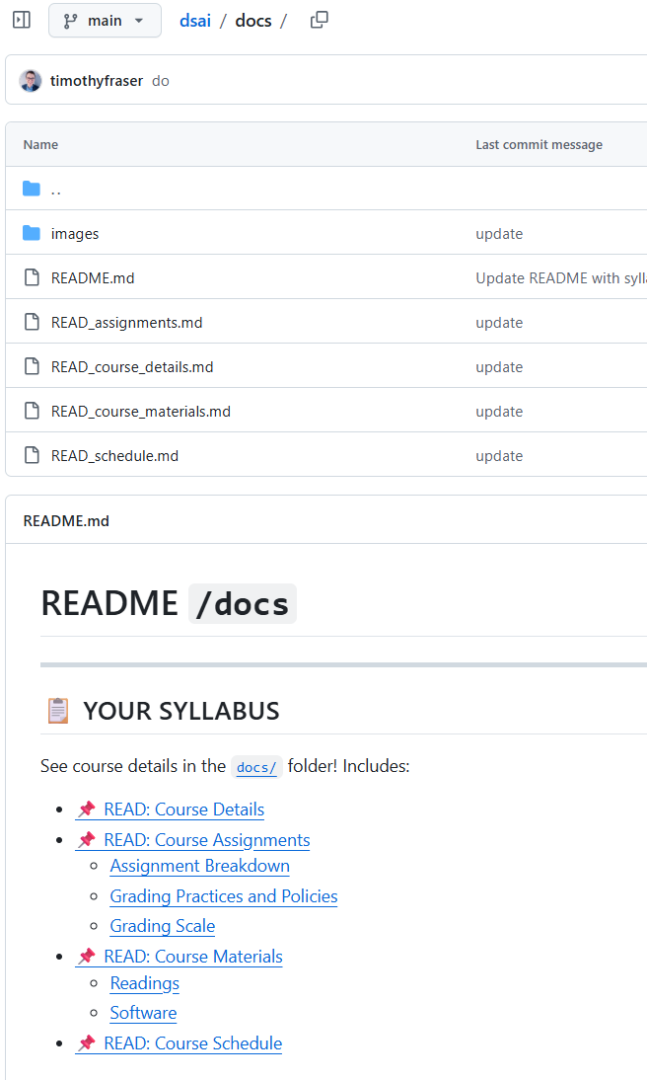
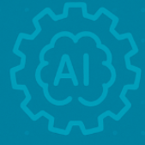
Next Steps
Date
01
02
03
04
Our Canvas Site
Our Github
Our Syllabus
Setting up

